Slide 1

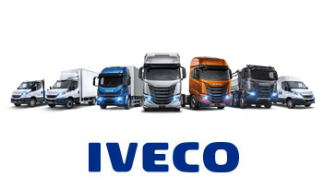

Presentation on
csps

Slide 2
Common Spare Parts System (CSPS) is a system integration launched by Fiat auto group in order to provide a common software system for different subsidiaries, CNHi, IVECO and FCA to support planning and execution activities day to day routines in spare parts business processes

Slide 3
Exor – Stellantis
Exor:
Exor is a holding company, controlled by the Agnelli family.
A holding company is a company whose primary business is holding a controlling interest in the securities of other companies.
A holding company usually does not produce goods or services itself. Its purpose is to own shares of other companies to form a corporate group.
Stellantis :
In December 2019, Fiat Chrysler Automobiles [FCA] and the PSA Group announced a merger.
In July 2020, FCA's Chairman John Elkann and the CEO Mike Manley announced that the combined company will be called Stellantis ,
The merger completed on 16 January 2021. At the completion date of merger, the combined company became the world's fifth-largest car maker by unit sales.

Slide 4
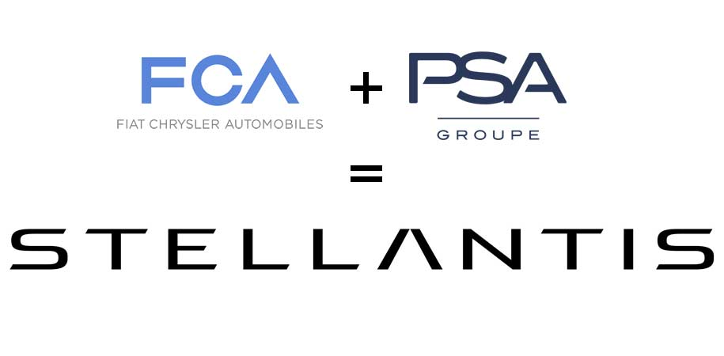

Slide 5
CNH Industrial - CNHi
HISTORY:
CNH : Case new holland
CNH Global was the holding company for the multinational manufacturer of agricultural and construction equipment established on 12 November 1999, through the merger of Case and New Holland.
Fiat Industrial was an Italian company, it served as a holding company for the activities of
Truck manufacturer Iveco. [Industrial vehicle corporation]
The agricultural and construction equipment producer CNH Global.
On 29 September 2013, CNH Global and Fiat Industrial were merged into CNH Industrial.

Slide 6

CNH Industrial is an American-Italian multinational corporation with global headquarters in Basildon, United Kingdom, but controlled and mostly owned by the Dutch-Italian investment company Exor.
CNH Industrial designs, produces, and sells agricultural machinery and construction equipment like
Trucks,
Commercial vehicles
Buses, and special vehicles (Iveco)
Fiat Chrysler Automobiles (FCA) was an Italian-American multinational corporation primarily known as a manufacturer of
Automobiles,
Commercial vehicles,
Auto parts and production systems.
The group was established in October 2014 through the merger of Chrysler Group and Fiat S.p.A.

Slide 7


Slide 8

CNHi has different environments:
* EMEA,
* NAFTA,
* ANZ
Regions
EMEA - Europe Countries,
NAFTA - North America,
LATAM - South America (Argentina , Brazil) ,
ANZ - Australia
Volumes
9 Million Spare parts ,
4 regions, 80 Warehouse,
40000 Users, we process 30000 orders per day

Slide 9
Streams:
CV SSU
CIA AGI
CIA EVO
CV SSU EVO
RIO
Overview of Modules:
Planning
Order processing
Warehouse management
Invoicing
Financing
Claims

Slide 10
Planning:
Determine future demand based on historical data analysis.
Determine the optimal safety stock in order to ensure the desired service level for the market .
Order processing:
Users from various countries and regions will access CSPS portal to submit their orders for spare parts.
During order entry, various mandatory checks will be performed like customer validations, network determination, Availability in the Warehouse, etc. Once all the checks are passed, order will be successfully submitted and then processed through various stages based on the type of order.
Based on the availability in warehouse/with other dealers(D2D)/ suppliers(DFS) Order will be assigned/allocated and sent to Warehouse for further process.

Slide 11
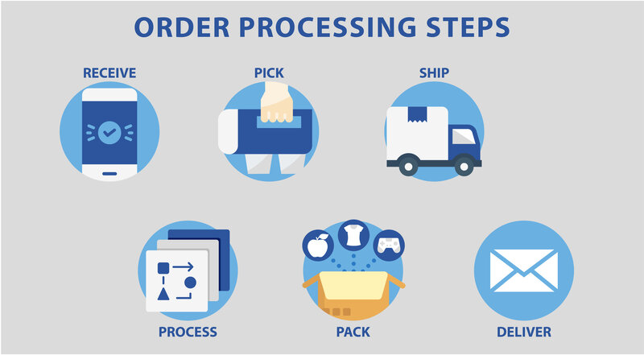

Slide 12
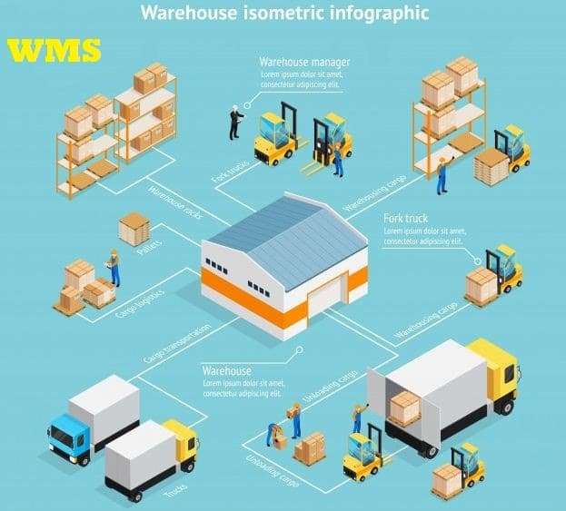
Warehouse management:
In which the stock of the parts will be managed. (Out of scope to CSPS)
Once the orders are allocated to Warehouse, the details will be sent to the respective warehouse to proceed with the pick, pack and shipment of the orders.
After the order shipped by the Warehouse the invoicing process will start.

Slide 13
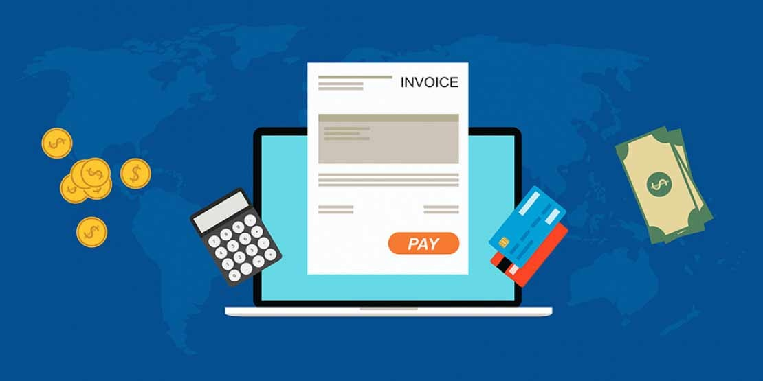
Invoicing:
As soon as an order is shipped by warehouse to the dealer, next step is to generate an invoice to charge the dealer for the ordered part.
An invoice can be generated via batch mode or via online processing.
Batch mode is preferred for normal orders or domestic orders.
Online mode is preferred in case of export orders or urgent orders.

Slide 14
There are 2 type of invoices generated in CSPS:
ICY (intercompany) invoice
A bill is created b/w the sending and the receiving warehouse to allow this stock transfer and to maintain payment b/w different warehouses.
2. Dealer invoice
This invoice is generated and charged to the dealer who has ordered parts in CSPS.
Post shipment of the goods to the dealer, this invoice is created.
A copy of all the bills generated in CSPS is sent to DOCMA (a central system to store all documents issued in CSPS).
Along with this, details are also sent to SAP FI system for accounting purpose via AP/AR interface

Slide 15

Claims:
After receiving the invoice, if dealer finds any anomaly in the invoice issued OR has issues related
to the part delivered, a claim can be placed.
Claim can be a price type claim or a quantity type claim.
Price type claim is usually selected where pricing anomalies are present in the issued invoice.
Quantity type claim is usually selected where there is an issue with the quality of the product received or mismatch in the quantity ordered and received.

Slide 16
Base Line:
Development Environment
Quality Assurance
Pre – Production
Production

Slide 17


